Slide 1
Group Members
Owais Ahmed Khan
Muhammad Shiraz

Slide 2
Project Goal
  Decode video scrambled using (r,s) line permutation
  Height processed in iterative power-of-two blocks
  Tasks: Detect key (r,s) + Unscramble video in real time

Slide 3
Main work of the GPU
  It performs two specific heavy-lifting tasks at the same time.
  Parallel Scoring, It checks thousands of potential keys simultaneously to find the correct one instantly, rather than checking them one by one.
  Parallel Pixel Moving, It moves millions of pixels at the same time to unscramble the video frames instantly.
  Think of it this way, The CPU is the manager that gives orders; the GPU is the army of thousands of workers that executes those orders all at once.

Slide 4
Step-by-Step Explanation
Load the scrambled video using OpenCV
Convert the first frame to grayscale for key evaluation
Generate all possible permutations for every candidate key (r, s) on the CPU
Send all permutations and the grayscale frame to the GPU
Score every key in parallel on the GPU using row similarity
Select the key with the lowest score (the correct unscrambling key)
Regenerate the full permutation for the best key
Send the best permutation to the GPU
Unscramble each video frame in parallel on the GPU using the permutation
Copy restored frames back to the CPU
Display the clean video and save it to a file

Slide 5
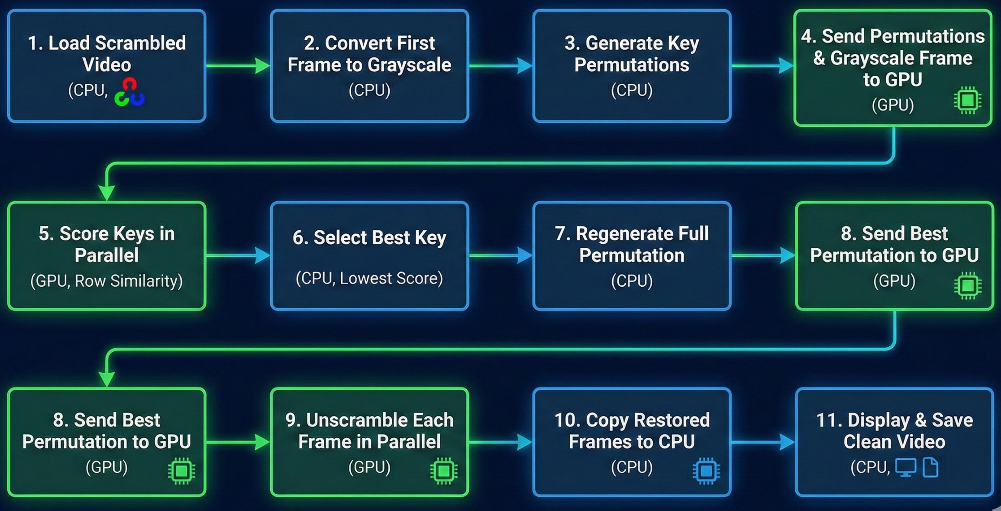
Step-by-Step Explanation

Slide 6
Scrambling formula
For one block of size lines (size must be a power of two)
Input (clear) line index:
idLine (0 at the top of the block)
Output (scrambled) line index:
  Scrambling rule: (r + (2s+1)*cleanRow) mod blockSize
Where:
r = offset on 8 bits
s = step on 7 bits
Together (r, s) is the secret key.

Slide 7
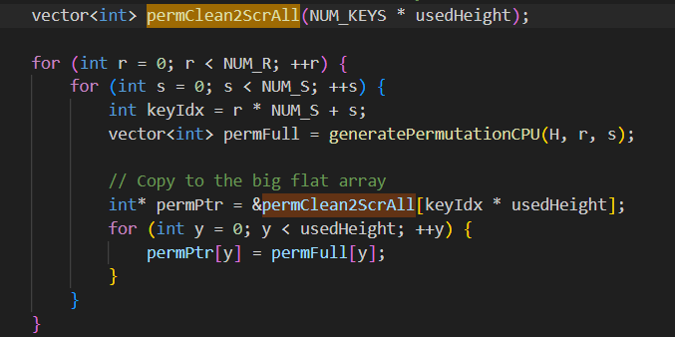
Exact Key Generation

Slide 8
Permutation Algorithm
  Iterative block decomposition (512→256→128→...)
  Compute mapping clean into scrambled for each key
  Implemented fully on CPU for efficiency

Slide 9
Why CPU for Permutations
  Avoids heavy per-thread math on GPU
  Prevents warp divergence
  Improves memory locality
  Jetson Nano has enough RAM to store all permutations

Slide 10
GPU Key Scoring Kernel
  1 block = 1 key
  256 threads per block compare rows
  Shared memory reduction
  Sparse pixel sampling (x += 4)

Slide 11
Unscramble Kernel
  32×32 threads per block
  1 thread = 1 pixel
  Coalesced memory access
  Real-time performance

Slide 12
Results
  Correct (r,s) consistently detected
  Clean video reconstruction
  Preview + FPS overlay + output saved

Slide 13
Results
  Correct (r,s) consistently detected
  Clean video reconstruction
  Preview + FPS overlay + output saved

Slide 14
Conclusion
  The project successfully demonstrated an end-to-end pipeline for recovering a scrambled video by automatically identifying the correct permutation key.
  A full key-search strategy was implemented, generating all candidate permutations on the CPU based on the mathematical scrambling function.
  GPU-accelerated scoring using CUDA enabled fast evaluation of 32,768 keys, significantly reducing processing time compared to a CPU-only brute-force approach.

Slide 15
Conclusion
  The correct key was determined by minimizing the inter-row similarity score, proving the effectiveness of the structural similarity metric used.
  The unscrambling kernel efficiently reconstructed each frame in parallel, showing the advantage of pixel-level parallelism on the GPU.
  OpenCV handled video I/O reliably, while CUDA performed the heavy computation, illustrating a well-balanced CPU–GPU hybrid design.
  The final restored video demonstrates that the approach is robust, scalable, and practical for real-time or near-real-time reconstruction.
  Overall, the project validates the power of GPU computation for inverse scrambling problems and provides a solid foundation for future work in video restoration, cryptanalysis, or image forensics.

